Slide 1
Array Techniques
Introduction

Slide 2
Array
Array is a container which can hold a fix number of items and these items should be of the same type. Most of the data structures make use of arrays to implement their algorithms. Following are the important terms to understand the concept of Array.
Element − Each item stored in an array is called an element.
Index − Each location of an element in an array has a numerical index, which is used to identify the element.

Slide 3
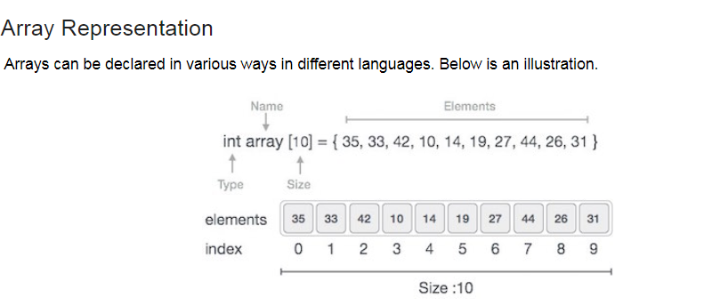
Array Representation
As per the above illustration, following are the important points to be considered.
Index starts with 0.
Array length is 10 which means it can store 10 elements.
Each element can be accessed via its index. For example, we can fetch an element at index 6 as 9.

Slide 4
Basic Operations
Following are the basic operations supported by an array.
Traverse − print all the array elements one by one.
Insertion − Adds an element at the given index.
Deletion − Deletes an element at the given index.
Search − Searches an element using the given index or by the value.
Update − Updates an element at the given index.

Slide 5
Array is created in Python by importing array module to the python program.
from array import *
arrayName = array(typecode, [Initializers])

Slide 6
Typecode are the codes that are used to define the type of value the array will hold. Some common typecodes used are:
Typecode | Value
b | Represents signed integer of size 1 byte (-128- to +127)
B | Represents unsigned integer of size 1 byte(0-255)
c | Represents character of size 1 byte (0-127)
i | Represents signed integer of size 4 bytes –(2,147,483,648 to 2,147,483,647)
I | Represents unsigned integer of size 4 bytes
f | Represents floating point of size 4 bytes
d | Represents floating point of size 8 bytes

Slide 7
Example
from array import *
array1 = array('i', [10,20,30,40,50])
for x in array1:
print(x)

Slide 8
Finding the length of an array
The length of an array is defined as the number of elements present in an array. It returns an integer value that is equal to the total number of the elements present in that array.
Syntax
len(array_name)

Slide 9
Accessing Array Element
from array import *
array1 = array('i', [10,20,30,40,50])
print (array1[0])
print (array1[2])

Slide 10
Insertion Operation
Insert operation is to insert one or more data elements into an array. Based on the requirement, a new element can be added at the beginning, end, or any given index of array.
Here, example of add a data element at the middle of the array using the python in-built insert() method.

Slide 11
Insertion Operation
from array import *
array1 = array('i', [10,20,30,40,50])
array1.insert(1,60)
for x in array1:
print(x)
array1.append(100)

Slide 12
Deletion Operation
Deletion refers to removing an existing element from the array and re-organizing all elements of an array.
Here, we remove a data element at the middle of the array using the python in-built remove() method.
from array import *
array1 = array('i', [10,20,30,40,50])
array1.remove(40)
for x in array1:
print(x)

Slide 13
Using Del function
import array as arr
number = arr.array('i', [10, 20, 30, 30, 40])
del number[2] # removing third element
print(number)

Slide 14
Search Operation
You can perform a search for an array element based on its value or its index.
Here, we search a data element using the python in-built index() method.
from array import *
array1 = array('i', [10,20,30,40,50])
print (array1.index(40))

Slide 15
Update Operation
Update operation refers to updating an existing element from the array at a given index.
Here, we simply reassign a new value to the desired index we want to update.
from array import *
array1 = array('i', [10,20,30,40,50])
array1[2] = 80
for x in array1:
print(x)

Slide 16
How to change or add elements
import array as arr
numbers = arr.array('i', [1, 2, 3, 5, 7, 10])
# changing first element
numbers[0] = 0
print(numbers) # Output: array('i', [0, 2, 3, 5, 7, 10])
# changing 3rd to 5th element
numbers[2:5] = arr.array('i', [4, 6, 8])
print(numbers) # Output: array('i', [0, 2, 4, 6, 8, 10])

Slide 17
Array Order Reversal Method reverse()
import array
#The original array
new_arr= array.array('i',[2,4,6,8,10,12])
print("Original Array is :",new_arr)
#reversing using reverse()
new_arr.reverse()
print("Reversed Array:",new_arr)

Slide 18
Using reversed() Method
import array
#The original array
new_arr=array.array('i',[10,20,30,40])
print("Original Array is :",new_arr)
#reversing using reversed()
res_arr=array.array('i',reversed(new_arr))
print("Resultant Reversed Array:",res_arr)

Slide 19
Reversing a NumPy Array in Python
The Numpy module allows us to use array data structures in Python which are really fast and only allow same data type arrays.
1. Using flip() Method
import numpy as np
#The original NumPy array
new_arr=np.array(['A','s','k','P','y','t','h','o','n'])
print("Original Array is :",new_arr)
#reversing using flip() Method
res_arr=np.flip(new_arr)
print("Resultant Reversed Array:",res_arr)

Slide 20
Using flipud() Method
The flipud() method is yet another method in the NumPy module which flips an array up/down. It can also be used to reverse a NumPy array in Python. Let us see how we can use it in a small example.
import numpy as np
#The original NumPy array
new_arr=np.array(['A','s','k','P','y','t','h','o','n'])
print("Original Array is :",new_arr)
#reversing using flipud() Method
res_arr=np.flipud(new_arr)
print("Resultant Reversed Array:",res_arr)

Slide 21
Using Simple Slicing
As we did earlier with lists, we can reverse an array in Python built with Numpy using slicing. We create a new NumPy array object which holds items in a reversed order.
import numpy as np
#The original NumPy array
new_arr=np.array([1,3,5,7,9])
print("Original Array is :",new_arr)
#reversing using array slicing
res_arr=new_arr[::-1]
print("Resultant Reversed Array:",res_arr)

Slide 22
Array Counting
myArray = [1, 2, 3]
print(len(myArray))

Slide 23
Array Concatenation

Slide 24
Use of count()
# vowels list
vowels = ['a', 'e', 'i', 'o', 'i', 'u']
# count element 'i'
count = vowels.count('i')
# print count
print('The count of i is:', count)
# count element 'p'
count = vowels.count('p')
# print count
print('The count of p is:', count)
Output
The count of i is: 2
The count of p is: 0

Slide 25
Array Counting
Using length method
Syntax:
len(array_name)
2. Using count variable
from array import *
array1 = array('i', [10,20,30,40,50])
count = 0
for x in array1:
count++
print(count)

Slide 26
FINDING THE MAXIMUM NUMBER IN A SET
#Initialize array
arr = [25, 11, 7, 75, 56];
#Initialize max with first element of array.
max = arr[0];
#Loop through the array
for i in range(0, len(arr)):
#Compare elements of array with max
if(arr[i] > max):
max = arr[i];
print("Largest element present in given array: "+ str(max));

Slide 27
Using max function
array = [456, 700, 200]
print("Max value element : ", max(array))

Slide 28
Finding the Maximum number in a set
numbers = [9, 34, 11, -4, 27]
# find the maximum number
max_number = max(numbers)
print(max_number)
2.
# Python code to get the maximum element from a set
def MAX(sets):
return (max(sets))
sets = set([8, 16, 24, 1, 25, 3, 10, 65, 55])
print(MAX(sets))
3.
# Python code to get the minimum element from a set
def MIN(sets):
return (min(sets))
sets = set([4, 12, 10, 9, 4, 13])
print(MIN(sets))

Slide 29
Array Splitting
#splitting in 3 parts
import numpy as np
arr = np.array([1, 2, 3, 4, 5, 6])
newarr = np.array_split(arr, 3)
print(newarr)
print(newarr[0])
print(newarr[1])
print(newarr[2])
Output:
[array([1, 2]), array([3, 4]), array([5, 6])]
[1, 2]
[3, 4]
[5, 6]

Slide 30
Array splitting
import numpy as np
# input array
in_arr = np.array([ 2, 0, 1, 5, 4, 9])
print ("Input array : ", in_arr)
out_arr = np.partition(in_arr, 3)
print ("Output partitioned array : ", out_arr)

Slide 31
Removal of Duplicates from an Ordered Array
1.
a = [1,1,1,3,4,5,5,5,5,7,7,7,9,9]
for i in range(len(a)-1,0,-1):
if a[i] == a[i-1]:
del a[i]
print(a)
Output: ?
2.
a=[1,1,1,3,4,5,5,5,5,7,7,7,9,9]
i =0
l = len(a)-1
while i < l :
if a[i] == a[i+1]:
del a[i+1]
l -=1
else :
i +=1
print(a)
Output: ?

Slide 32
Chapter 5: Syllabus
Array Techniques: Introduction
– Array Order Reversal
– Array Counting
– Finding the Maximum number in a set
– Removal of Duplicates from an ordered array
– Partitioning an array
– Finding the Kth smallest element
Python Lists: List operations
– Tuples
– Sets Operations
– Dictionaries
– Time Tradeoff.

Slide 33
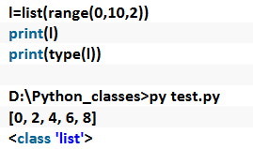
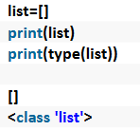
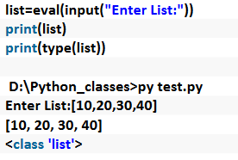
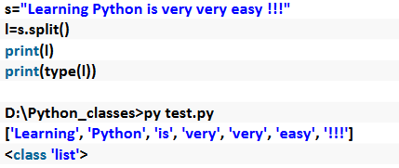
List
Create list

Slide 34
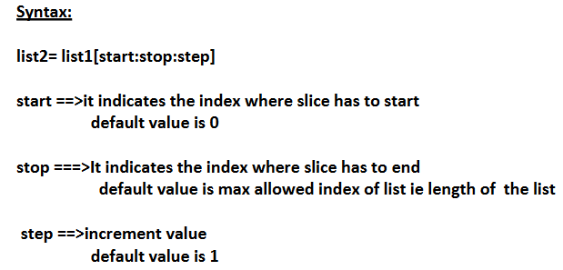
Slice Operator

Slide 35
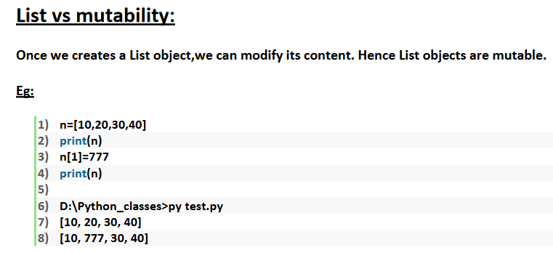

Slide 36
Python List: List Operations
Method | Description
append() | Adds an element at the end of the list
clear() | Removes all the elements from the list
copy() | Returns a copy of the list
count() | Returns the number of elements with the specified value
extend() | Add the elements of a list (or any iterable), to the end of the current list
index() | Returns the index of the first element with the specified value
insert() | Adds an element at the specified position
pop() | Removes the element at the specified position
remove() | Removes the first item with the specified value
reverse() | Reverses the order of the list
sort() | Sorts the list

Slide 37
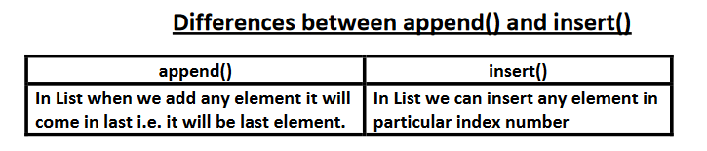

Slide 38
Some Examples:
append()
Example:
fruits = ["apple", "banana", "cherry"]
fruits.append("orange")
print(fruits)
output: [ ‘apple’ , ‘banana’ , ‘cherry’ , ‘orange’]
clear()
Example:
fruits = ["apple", "banana", "cherry"]
fruits.clear()
print(fruits)
output: []

Slide 39
Tuple Operations
Method | Description
count() | Returns the number of times a specified value occurs in a tuple
index() | Searches the tuple for a specified value and returns the position of where it was found

Slide 40
Set Operations
Method | Description
add() | Adds an element to the set
clear() | Removes all the elements from the set
copy() | Returns a copy of the set
difference() | Returns a set containing the difference between two or more sets
difference_update() | Removes the items in this set that are also included in another, specified set
discard() | Remove the specified item
intersection() | Returns a set, that is the intersection of two or more sets
intersection_update() | Removes the items in this set that are not present in other, specified set(s)
isdisjoint() | Returns whether two sets have a intersection or not

Slide 41
Set Operations
Method | Description
issubset() | Returns whether another set contains this set or not
issuperset() | Returns whether this set contains another set or not
pop() | Removes an element from the set
remove() | Removes the specified element
symmetric_difference() | Returns a set with the symmetric differences of two sets
symmetric_difference_update() | inserts the symmetric differences from this set and another
union() | Return a set containing the union of sets
update() | Update the set with another set, or any other iterable

Slide 42
Dictionary Operations
Method | Description
clear() | Removes all the elements from the dictionary
copy() | Returns a copy of the dictionary
fromkeys() | Returns a dictionary with the specified keys and value
get() | Returns the value of the specified key
items() | Returns a list containing a tuple for each key value pair
keys() | Returns a list containing the dictionary's keys
pop() | Removes the element with the specified key
popitem() | Removes the last inserted key-value pair
setdefault() | Returns the value of the specified key. If the key does not exist: insert the key, with the specified value
update() | Updates the dictionary with the specified key-value pairs
values() | Returns a list of all the values in the dictionary

Slide 43
String Operations
Method | Description
capitalize() | Converts the first character to uppercase
casefold() | Converts string into lower case
center() | Returns a centred string
count() | Returns the number of times a specified value occurs in a string
islower() | Returns True if all characters in the string are lower case
isupper() | Returns True if all characters in the string are upper case
endswith() | Returns true if the string ends with the specified value
expandtabs() | Sets the tab size of the string
find() | Searches the string for a specified value and returns the position of where it was found

Slide 44
String Operations
Method | Description
format() | Formats specified values in a string
format_map() | Formats specified values in a string
join() | Converts the elements of an iterable into a string
lower() | Converts a string into lower case
upper() | Converts a string into upper case
title() | Converts the first character of each word to upper case
replace() | Returns a string where a specified value is replaced with a specified value
split() | Splits the string at the specified separator, and returns a list
split() | Splits the string at the specified separator, and returns a list

Slide 45
Some Examples
capitalize()
Example:
txt = "hello, and welcome to my world."
x = txt.capitalize()
print (x)
Output:
Hello, and welcome to my world.
islower()
Example:
txt = "hello world!"
x = txt.islower()
print(x)
Output :
True

Slide 46
Time Tradeoff
Sometimes the choice of an algorithm that involves a space-time tradeoff. That is by increasing the amount of space for storing the data, we may be able to reduce the time needed for processing data or vice-versa.
Basically it is a way of solving problems in:
Less time by using more memory
Solving a problem in little space by spending a long time.
TYPE OF TIME SPACE TRADE OFF:
Compressed / Uncompressed data
Re -Rendering / Sorted image
Smaller code / Loop Unrolling
Lookup table / Recalculation

Slide 47
Time Tradeoff Cont.
Compressed / Uncompressed data:
A space time trade off can be applied to the problem of solving data storage. If data is uncompressed it take more space but less time.
If data is compressed it takes less space but more time to run decompressed data.
Re -Rendering / Sorted image:
Sorting only the source and rendering an image every time a page is requested would be trading time for space.
More time used but less space.
Sorting the image would be trade space for time.
More space used but less time.

Slide 48
Time Tradeoff Cont.
3. Smaller code(with loop) / Larger code(without loop):
Smaller code occupies less space in memory but it require high computation time which is required for jumping back to the beginning of the loop at the end of each iteration.
Larger code or loop unrolling can be trade of higher programming speed. It occupies more space in memory but require less computation time.
4. Lookup Table/ Recalculation:
In lookup table an implementation can include the entire table which reduce computing time but increase the amount of memory needed.
It can recalculate i.e. compute table entire as needed, increasing computing time but reducing memory requirement.

